Slide 2
Dynamic Memory Manager in Linux using C language
Project Guide
Ms. Avita Katal
Assistant Professor (SS)
Systemics Cluster
School of Computer Science, UPES

Slide 3
Team Members & Role
MEMBERS | ROLL NO. | ROLES
Vitesh Sethi | R110219154 | Research and Coding
Ansh Gupta | R177219035 | Testing and Coding
Aryan Rastogi | R177219053 | Research and Coding

Slide 4
Introduction
Memory Allocation is a process by which a user-space process/application is allocated or de-allocated with physical/virtual memory space by the Kernel Memory Management Unit.
In this project, we are working on Dynamic Memory Allocation that stores processes in Heap virtual memory.
As in the C programming language, the Dynamic memory is handled by standard Glibc library functions such as malloc() and free(). In this project, we have built a customized memory manager using Linux OS system calls such as mmap() and munmap().

Slide 5
Literature Review
The authors of [1] present Hoard, a fast, highly scalable allocator that is memory economical and eliminates false sharing. Hoard is the first allocator to address all of the aforementioned difficulties at the same time. Hoard combines a global heap and per-processor heaps with a unique discipline that, in the common situation, provably limits memory usage and has extremely low synchronization costs.
Jemalloc [2] is one such heap manager that tackles these issues by utilizing several allocation zones. To assign arenas to threads, Jemalloc use a round-robin method.
The authors of [3] provide a versatile and efficient framework for creating memory allocators. The technique provided here enables programmers to create bespoke and general-purpose allocators as "heap layers" that may be combined without incurring any additional runtime overhead or programming expense.

Slide 6
Problem Statement
The standard Glibc library functions malloc() and free() face the problem of Fragmentation of memory due to continuous allocations and deallocations made via user.
Also, a track needs to maintained of memory statistics when we use the standard Glibc library which is a cumbersome task.

Slide 7
Objectives
To develop a custom memory manager that is capable of allocating and deallocating memory to a process/application.
To overcome the issue of memory fragmentation, that is one of the major issues in the standard Glibc library.
To show statistics of memory in use via every structure so that programmer need not keep track of what has been allocated and deallocated.

Slide 8
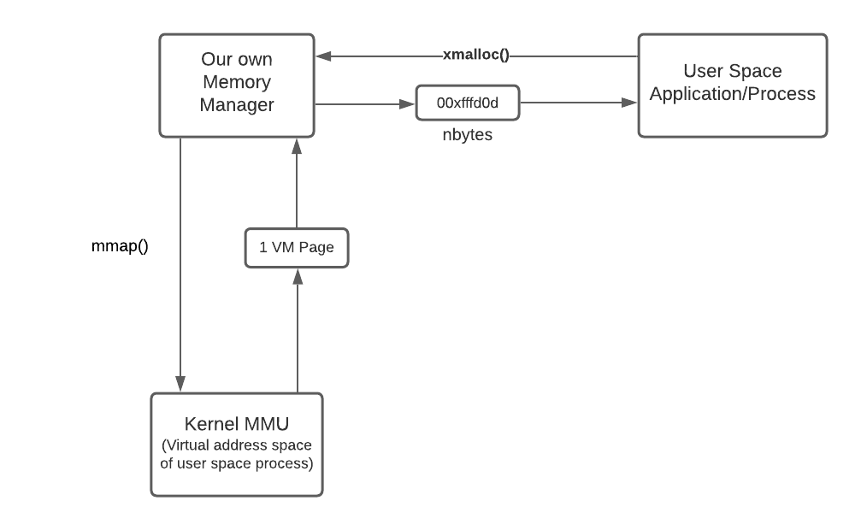
Methodology
Methodology divided into three parts-
User Space Process/Application - Any standard C program can serve as a user-space application/process which can demand memory allocation and de-allocation.
Our Memory Manager – get the virtual memory complete page and it will further split page to meet the application hunger for memory accordingly.
Kernel Memory Management Unit - It provides Virtual Memory Pages to our memory manager as per the request made by it.
We have used the iterative waterfall model in the development phases.
Fig 1. Customized Memory Manager

Slide 9
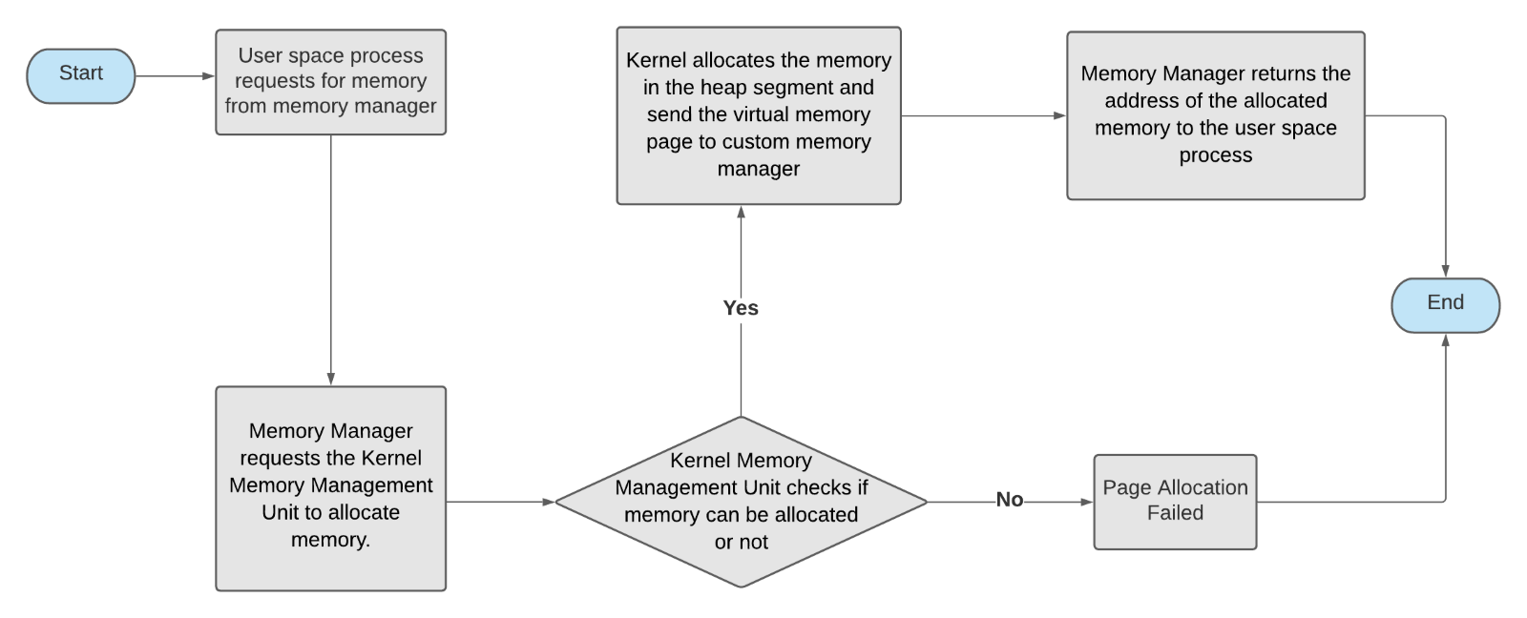
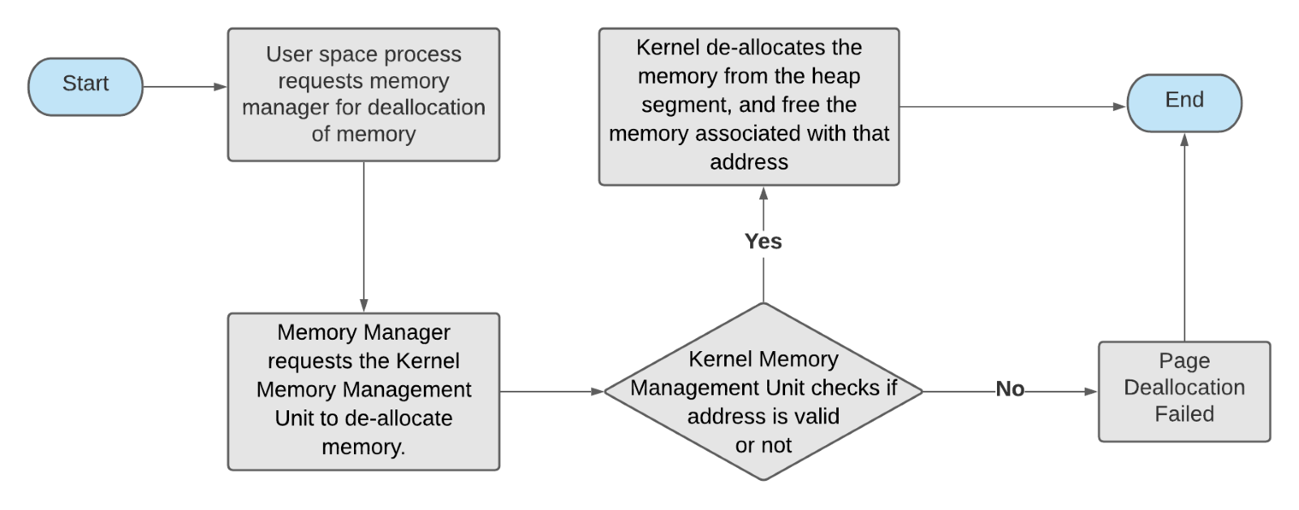
Algorithm
Fig 2. Algorithm for allocation of memory
Fig 3. Algorithm for de-allocation of memory

Slide 10
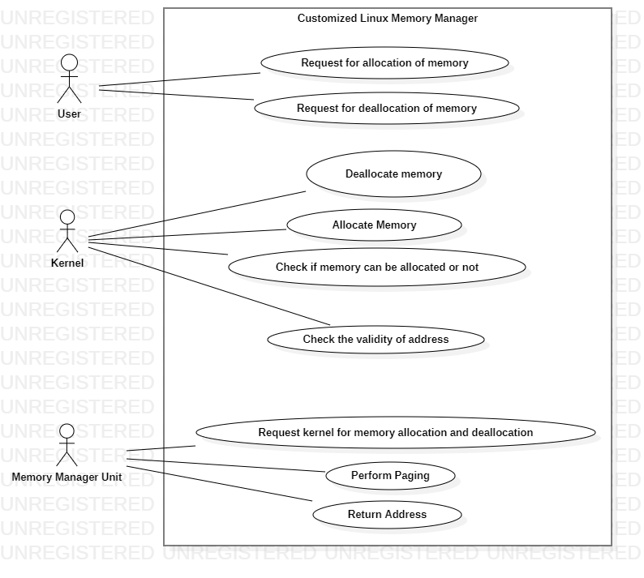
Use Case Diagram
Fig 4 shows the use cases and the actors in the proposed Linux memory manager. User, Kernel and Memory Manager Unit are the actors of the system.
Fig 4. Use Case Diagram

Slide 11
Experimental Setup
System Requirements: ​
Recommended Operating Systems​
Operating System: Linux ​
Hardware Requirements:​
1.Processor: Minimum 1 GHz .​​
2. Memory (RAM): Minimum 4 GB.​
Other Software used : (For Compilation of the project)
​
1. Gedit Editor
2. GCC Compiler

Slide 12
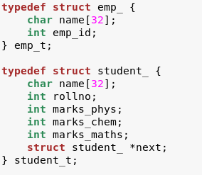
Results
For testing, continuous allocations and deallocations have been performed over two 2 structures student_t and emp_t.
Size of structure emp_ = 36 bytes
Size of structure student_ = 56 bytes

Slide 13
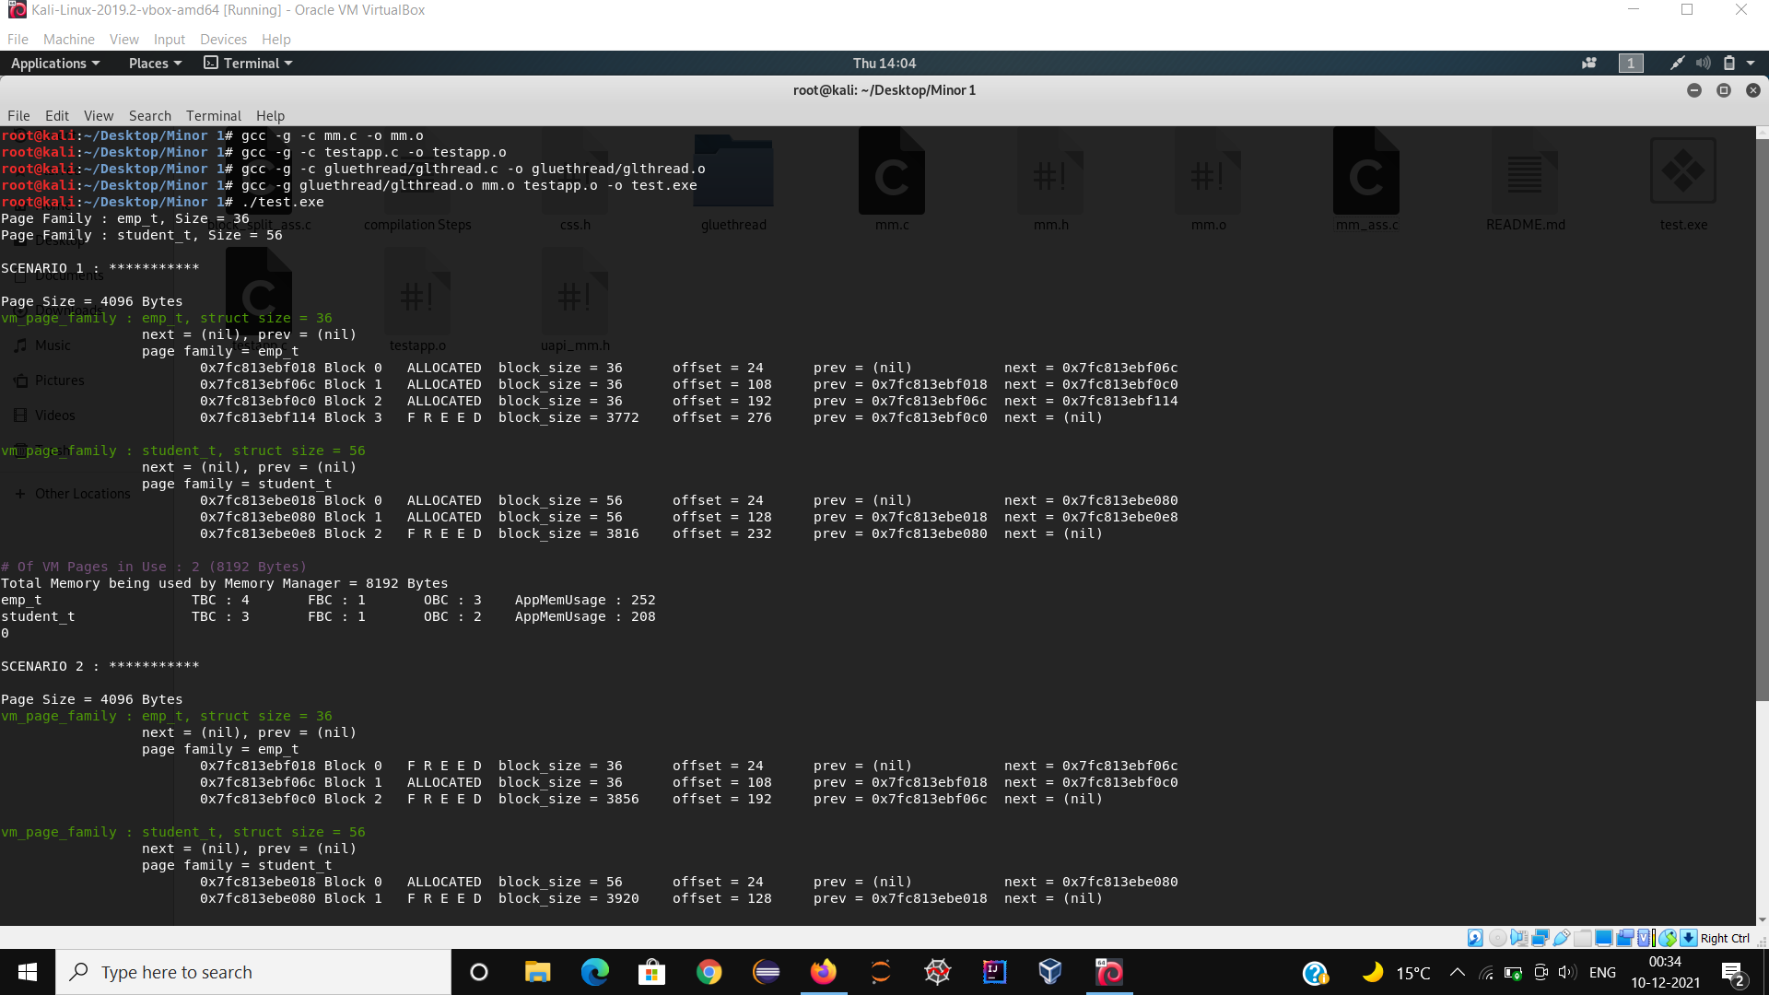
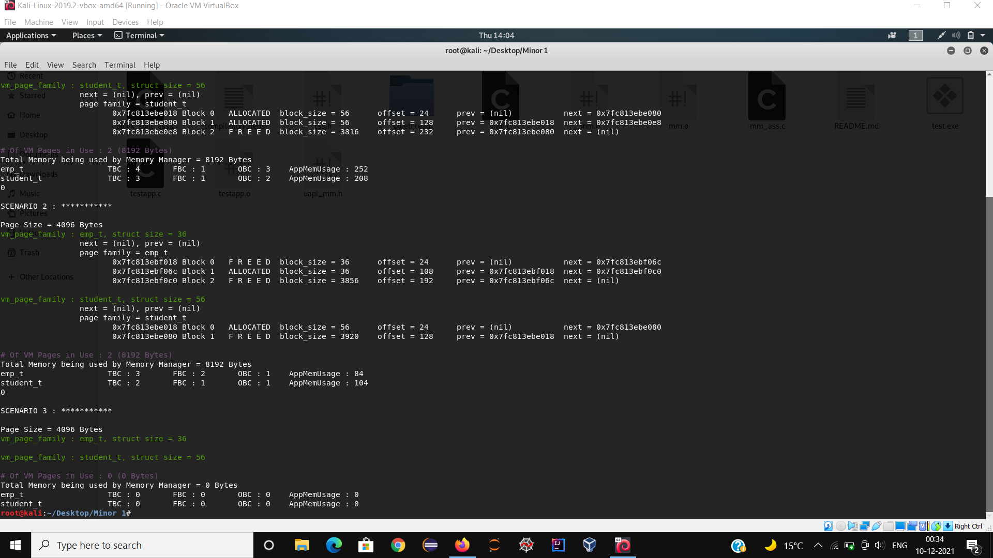
For testing purpose, continuous allocations and de-allocations of structures emp_t and student_t have been performed and clearly the statistics of memory being allocated and deallocated can be inferred from fig 5 and 6.
Fig 5. Output Screen 1
Fig 6. Output Screen 2

Slide 14
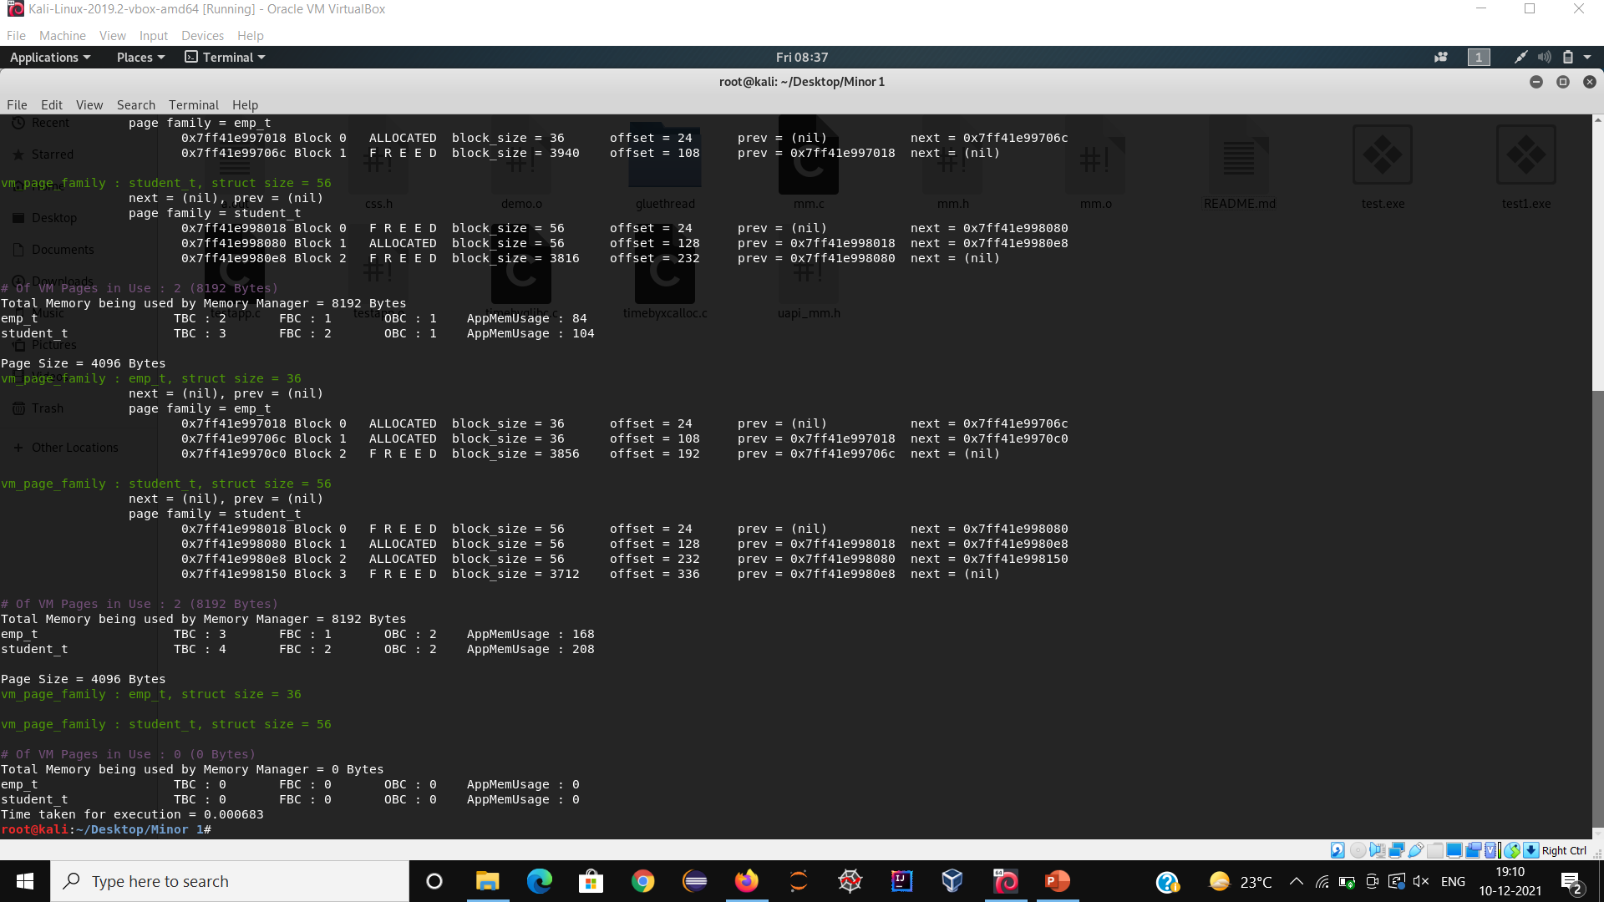
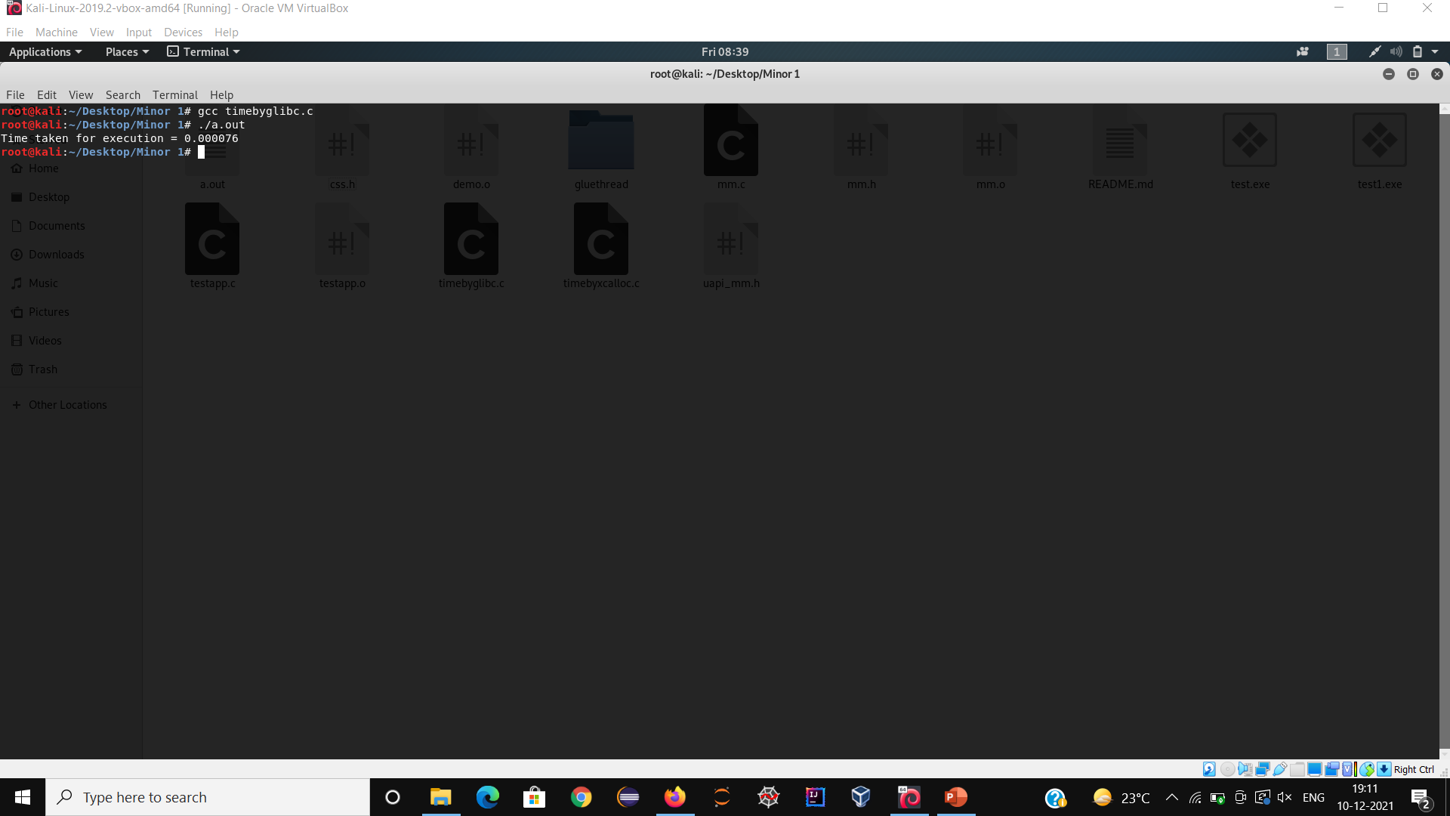
Comparative Analysis
In the below screenshots a comparative analysis have been performed between the custom memory manager and standard Glibc library. Though Glibc library takes less time to execute but still in case of memory statistics the proposed memory manager outperforms the standard Glibc library.
Fig 7. Custom memory manager time= 0.000683 seconds
Fig 8. Standard Glibc library time= 0.000076 seconds

Slide 15
Applications
Custom memory allocators are used by students, programmers and technical companies working in the system programming domain in order to overcome the limitations of the standard Glibc memory manager.
In this project, a similar custom memory allocator is being developed that can be applied in place of the standard memory manager.

Slide 16
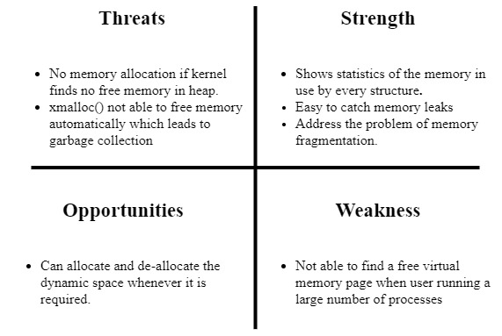
SWOT Analysis

Slide 17
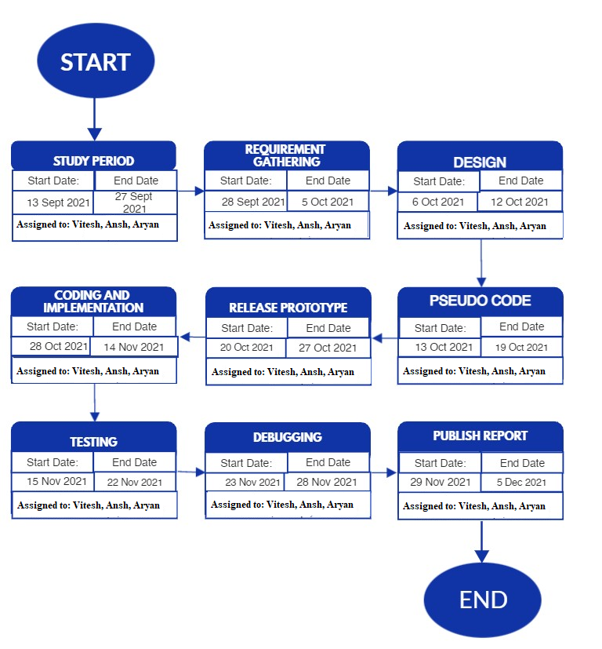
PERT CHART

Slide 18
References & GIT link
GitHub Link: https://github.com/anshgupta728/Dynamic_Memory_Manager_in_Linux
[1] E. D. Berger, K. S. McKinley, R. D. Blumofe, and P. R. Wilson, “Hoard: a scalable memory allocator for multithreaded applications,” ACM SIGARCH Computer Architecture News, vol. 28, no. 5, pp. 117–128, 2000. .
[2] J. Evans, “A Scalable Concurrent malloc(3) Implementation for FreeBSD,” 2006.
[3] “Scalable memory allocation using jemalloc Facebook Engineering.” https://engineering.fb.com/2011/01/03/core-data/scalable-memory-allocation-using-jemalloc/ (accessed Oct. 25, 2021).

